Slide 1
Food chain length in branching river networks
Terui lab meeting Feb 23
Justin Pomeranz

Slide 2



Food chain length
The number of levels in a food chain

Slide 3
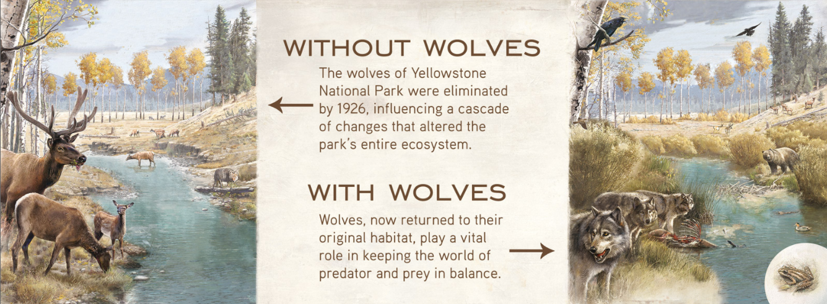
Food chain length is important for population control
livingwithwolves.org

Slide 4




Bioaccumulation of pollutants
Mercury in ocean fish
DDT in birds of prey
Mercury concentration
Trophic level

Slide 5
What drives food chain length?
Three main theories
Productivity
Disturbance
Size

Slide 6
Productivity
Laws of thermodynamics
Only ~10% of energy available
For higher level
Trophic level
Abundance

Slide 7
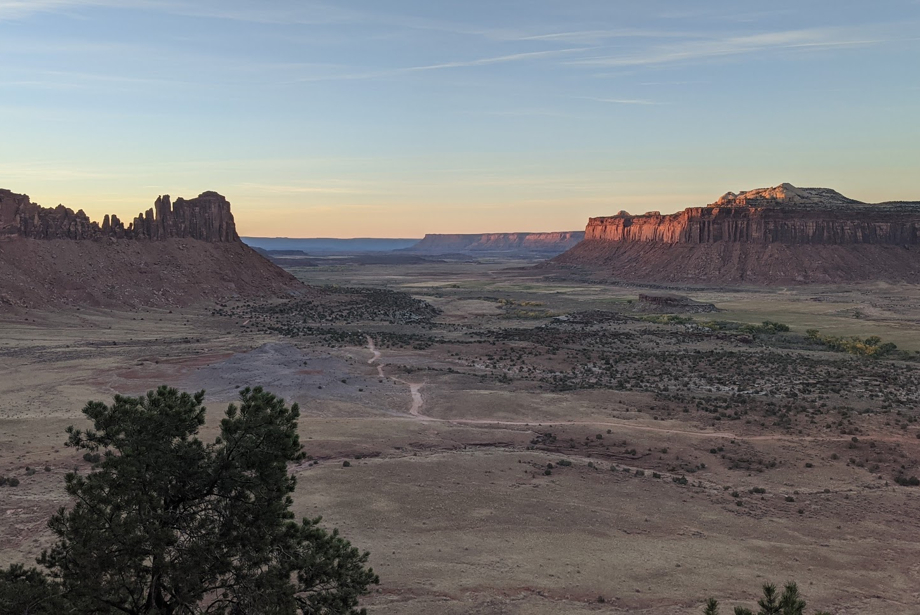
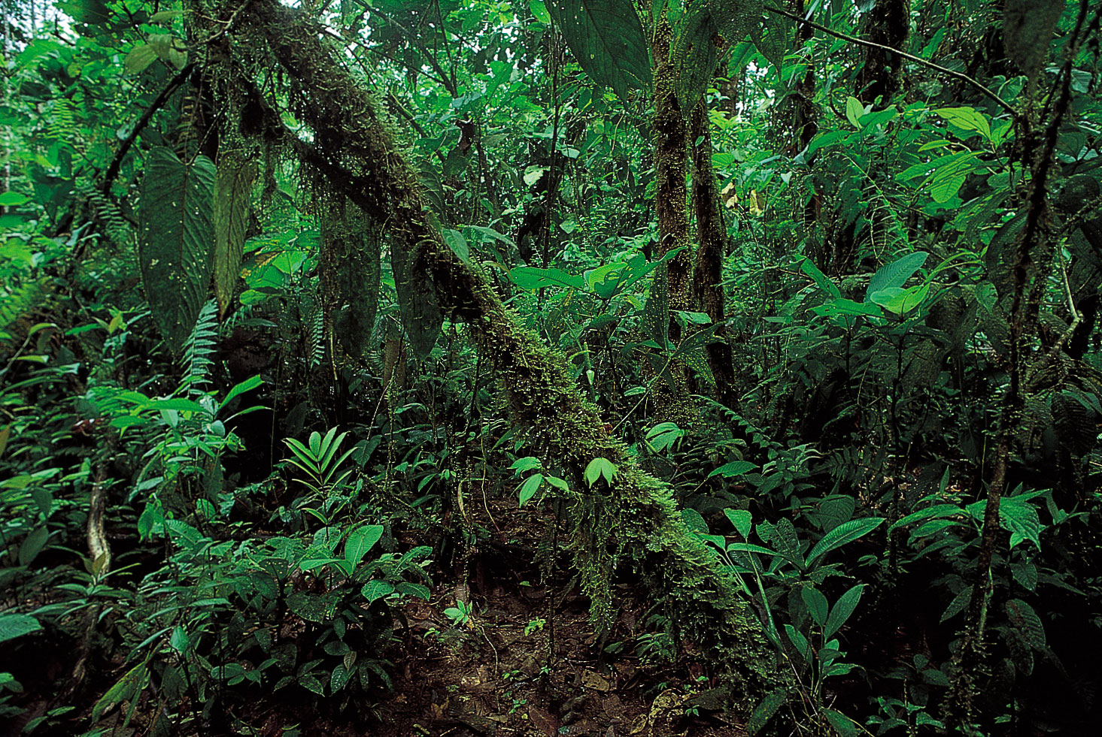
Productivity
More “stuff” = more trophic levels

Slide 8


Productivity

Slide 9
Disturbance
Higher trophic levels take time to establish, more likely to be extirpated
Disturbance “resets” the clock
Disturbance
Disturbance
Trophic level
Trophic level
Time
Time

Slide 10
Ecosystem size
Predators generally need more space
Larger area = higher probability higher trophic levels
Trophic level
Ecosystem Size

Slide 11
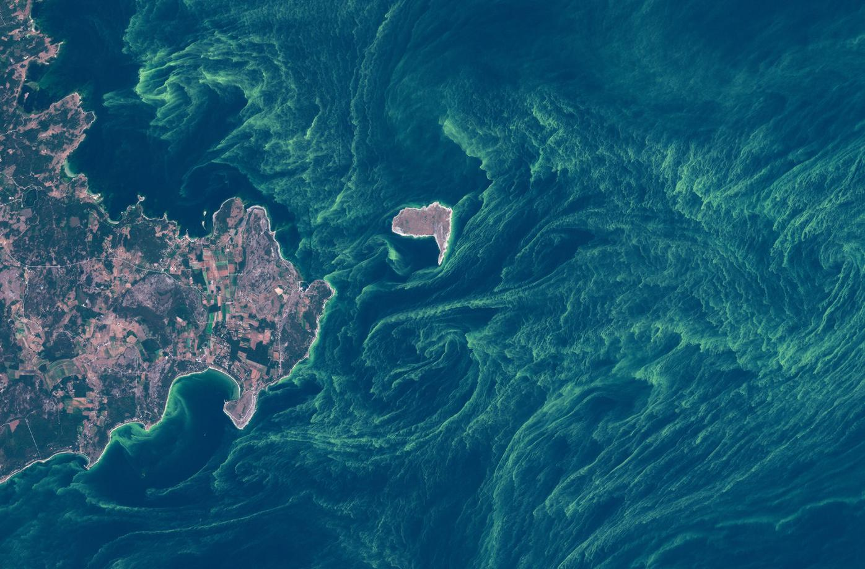
Ecosystem size
Predators generally need more space

Slide 12
Ecosystem size
Predators generally need more space

Slide 13
Ecosystem size
Predators generally need more space

Slide 14
Size in branching networks is different
Complex structure

Slide 15
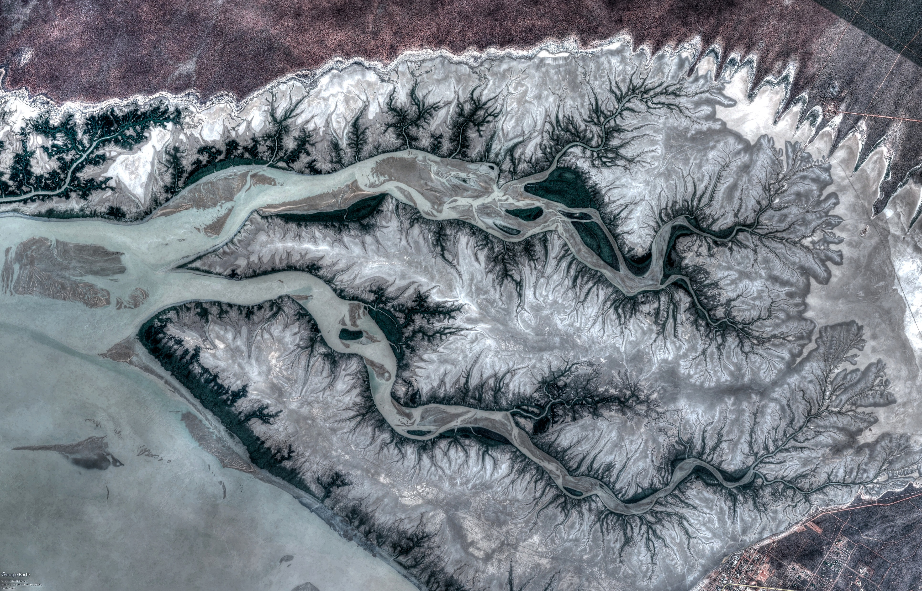

Slide 20
Complexity is independent of size
General ecological theories may not hold
Equivocal support for FCL~ Area theory
Pro – Sabo et al. 2010
Con – Warfe et al. 2013

Slide 21
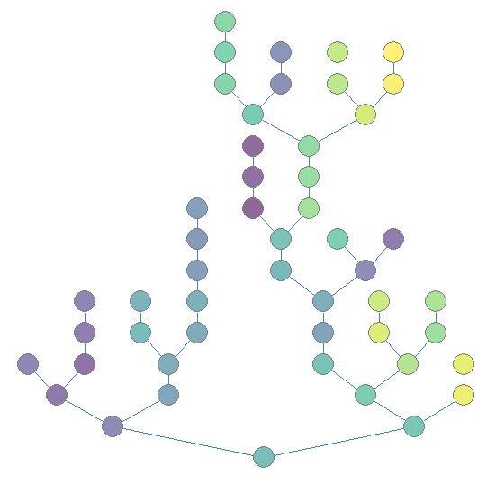
Simulation model overview
Habitat patches
Branching structure
Population Dynamics:
Individuals disperse
Species interact
Survivors reproduce
Repeat

Slide 22
FCL theories
Productivity
Based on environment (node color)
Watershed area (number nodes upstream)
Disturbance
Probability and magnitude
Size
Number of nodes

Slide 23
FCL theories
Productivity
Based on environment (node color)
Watershed area (number nodes upstream)
Disturbance
Probability and magnitude
Size
Number of nodes
Complexity
Branching probability

Slide 24
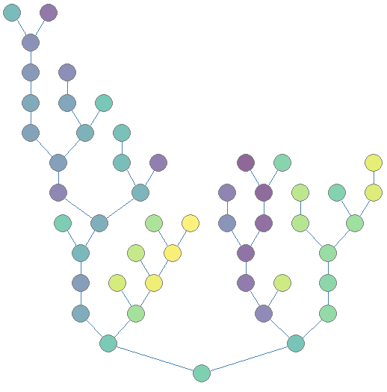
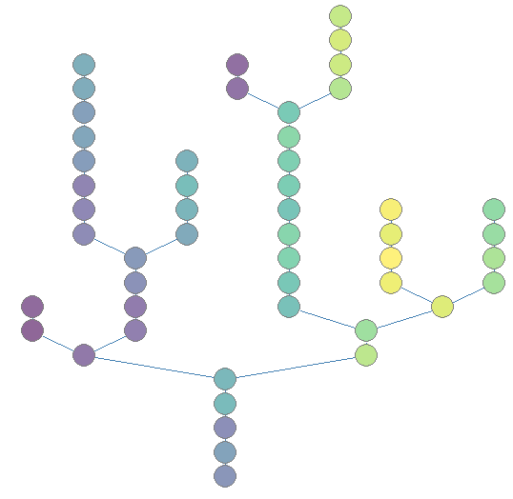
Branching complexity
Branch = 0.2
Branch = 0.5
Branch = 0.8

Slide 25
Simulation model
P
Three species community
B – basal
C – consumer
P – Predator
C
B

Slide 26
Simulation model
P
Three species community
Both C and P eat B
C
B

Slide 27
Simulation model
P
Three species community
Both C and P eat B
P also eats C
P – B = Intraguild predation
(without would be a simple food chain)
C
B

Slide 28
Possible communities
P + C + B
FCL = 3
C + B
FCL = 2
P + B
FCL = 2
B
FCL = 1
P
P
P
P
C
C
C
C
B
B
B
B

Slide 29
Possible communities
NOTE: same but different!
P + C + B
FCL = 3
C + B
FCL = 2
P + B
FCL = 2
B
FCL = 1
P
P
P
P
C
C
C
C
B
B
B
B

Slide 30
Possible communities
NOTE: same but different!
P + C + B
FCL = 3
C + B
FCL = 2
P + B
FCL = 2.5
B
FCL = 1
P
P
P
P
C
C
C
C
B
B
B
B

Slide 31
Assumptions
P
One generation per year
Predation occurs continuously
Synchronous reproduction occurs at end of season (discrete)
Typical of aquatic insect communities
Extinction can occur from demographics, disturbance, or from species interactions
If B goes extinct, P and C also go extinct
C
B

Slide 32
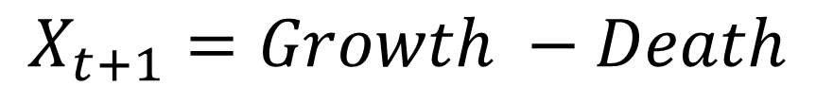
Lotka-Volterra dynamics
P
Simulate population abundances through time
C
$$X_{t+1}=Growth −Death$$
B
Form can vary widely
Growth – Exponential, Logistic
Death – predation, other, per capita

Slide 33
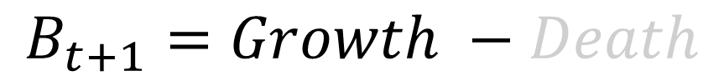
Population growth
P
Simulate population abundances through time
B has logistic growth in absence of predators
$$B_{t+1}=Growth −Death$$
C
B
Carrying capacity K
Population
time

Slide 34
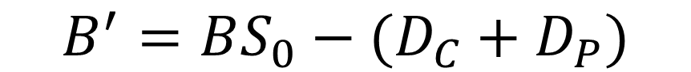
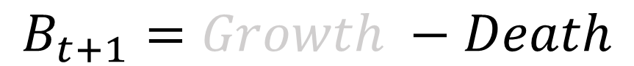
Population growth
P
Simulate population abundances through time
B has logistic growth in absence of predators
C
$$B_{t+1}=Growth −Death$$
Death – divided into predation by C and P, general survival probability
B
$$B^{′}={BS_{0}−(D}_{C}+D_{P})$$

Slide 35
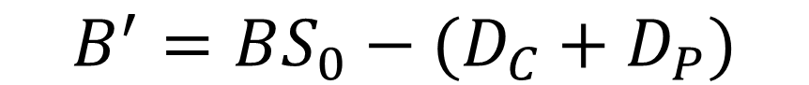
Individuals alive at end of season
P
$$B^{′}={BS_{0}−(D}_{C}+D_{P})$$
C
Pop size at end of season
B

Slide 36
Individuals alive at end of season
P
$$B^{′}={BS_{0}−(D}_{C}+D_{P})$$
C
Pop size at end of season
Pop size
Probability
Survive
B

Slide 37
Individuals alive at end of season
P
$$B^{′}={BS_{0}−(D}_{C}+D_{P})$$
C
Pop size at end of season
Pop size
Probability
Survive
# eaten by C and P
B

Slide 38
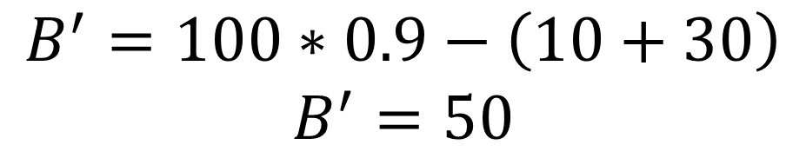
Individuals alive at end of season
P
$$B^{′}={BS_{0}−(D}_{C}+D_{P})$$
C
Pop size at end of season
Pop size
Probability
Survive
# eaten by C and P
B
$$B^{′}=100∗0.9−\left(10+30\right)$$
$$B^{′}=50$$

Slide 39
Discrete reproduction
P
B’ → logistic growth
Determined by r_{max} and K
C
Carrying capacity K
B’
B
Population
time

Slide 40
Type II predation
Predation depends on number of predators and prey
Reproduction depends on # prey eaten
P
C
# Prey consumed
B
Prey Density

Slide 41
Coexistence depends on IGP strength
Weak IGP
= stable
Strong IGP
= Unstable
No IGP = stable
P
P
P
C
C
C
B
B
B

Slide 42
Type II predation
Predation depends on number of predators and prey
Reproduction depends on # prey eaten
P
C
# Prey consumed
B
Prey Density

Slide 43
Dispersal occurs after reproduction
Individuals emigrate (E) a patch with some probability
Enter neighboring patch (I) based on distance

Slide 44
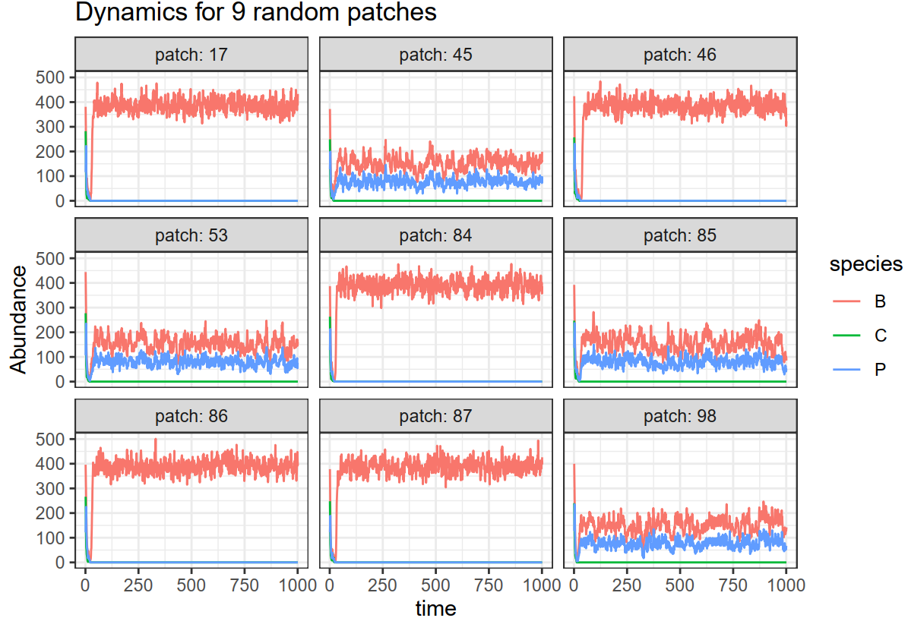
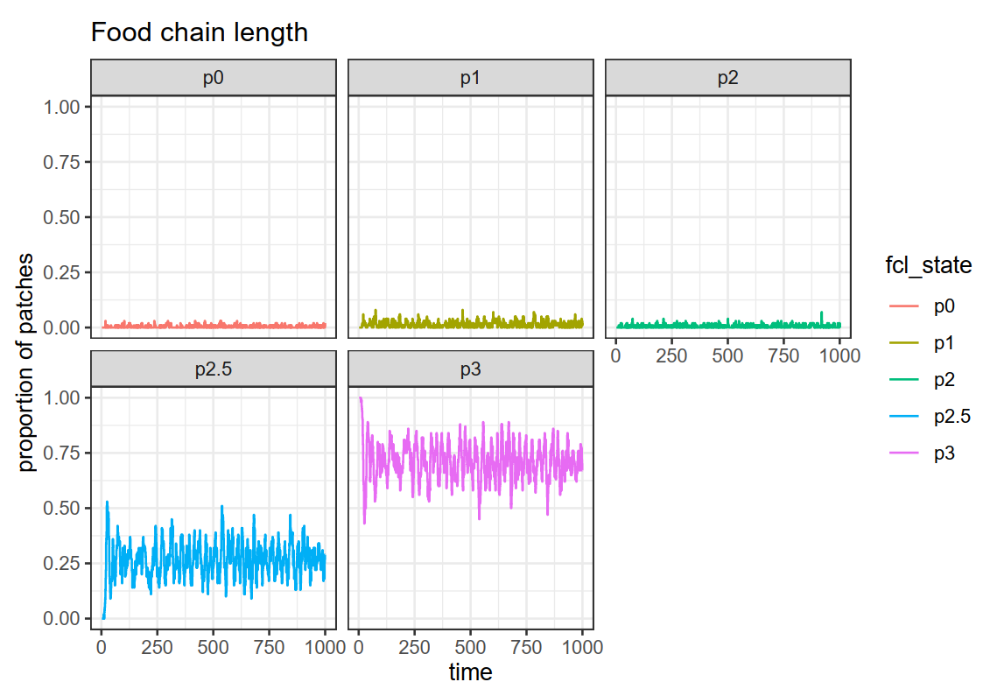
Working on R function to simulate dynamics

Slide 45
Environmental parameters
Productivity
Disturbance
Size
Complexity
Biotic parameters
Species growth rates
Strength of trophic interactions
Dispersal probability and distance

Slide 46
Environmental parameters
Productivity
Disturbance
Size
Complexity
FCL~ complexity
?
Biotic parameters
FCL
Species growth rates
Strength of trophic interactions
Dispersal probability and distance
Branching complexity

